Slide 2
System Integrity Tool
Project Exhibition I

Slide 3
Contents
Introduction
Existing Work
Proposed Work
Probable Application Area
Hardware and Software Requirements
Overall System Architecture

Slide 4
Introduction
Unauthorized changes to the data on your computer or portable storage devices can be carried out by various types of malware, if the 'intruder' is able to read or modify your data.
One way to recognize changes made to any file is by generating the hash sum of the file and comparing it before and after the data has been changed. MD5 is one such hashing algorithm that can be used to generate hashing sum for any file.
For a file, even if a single bit of data is modified, its whole hash sum will change.
S.I.T uses the MD5 algorithm to generate hash sums for given file and compare the hashing sums at a later date. This tool can be used to detect changes in a system on a file by file basis.

Slide 5
Existing Work
In this field several tools have been developed for various purposes, each with their own set of capabilities.
A tool called Regshot is used to take snapshots of the Windows Registry and compare it with previous snapshots.
In Windows the System File Checker utility checks all critical OS files from hashes stored in a “.wim” file and verifies them for corruption or no corruption.
Hash calculation is built into places like OS installers, raw image creation tools and is used to verify that if the image was created/installed properly.
All of these tools have a specialized usage.

Slide 6
Proposed Work
We propose to build a general purpose hash calculation and comparison tool.
This tool will generate hashes for every file in a given directory or for a single file and will save it in the user desired location.
These will be stored as “.hash” files.
The “.hash” files can be used later to check and verify the integrity of the files.
The “.hash” files will be organized automatically in an easily accessible manner for one on one comparison.

Slide 7
Probable Application Area
This tool can be used for auditing system architecture. The system administrator can use it to check system health and corruption levels to point out which modules need maintenance.
Tech enthusiasts can use it to trace system folders over time to see which files change as data processing occurs and learn how updates take place.
Colleges can use it to store hashes of ERP software and database and verify it from time to time to make sure no tampering takes place.
Developers can integrate this tool into their own software, or automate it to check and verify system integrity from time to time.

Slide 8
Hardware and Software Requirements
Memory: Minimum 32 MB
Storage: Minimum 5 MB
Processor: Minimum 400 MHz, 64-bit architecture
Operating System: Linux
Read privileges to files
Write privileges to filesystem
Integrated/External Keyboard

Slide 9
Overall System Architecture
Filesystem module: This module receives the top level directory or the filename as input from the user. It checks for all files in a directory and calls the hash generation or hash comparison functions, as input by user.
Hash generation function: This module generates a “.hash” file from the source file and saves it in the specified destination.
Hash comparison: This module generates a hash value of the source file and compares it along the “.hash” file from specified location.
Main control: This is the driver code of the function that decides which modules to call on the basis of the arguments given in the command line.

Slide 10
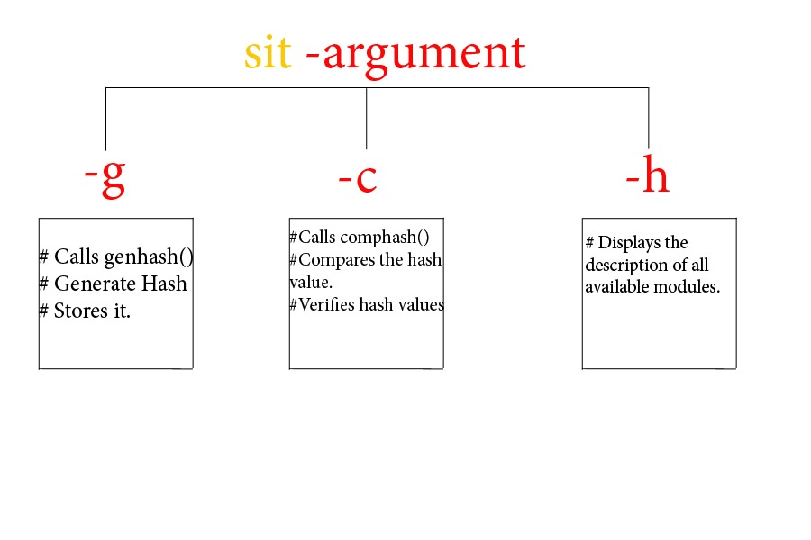

Slide 11
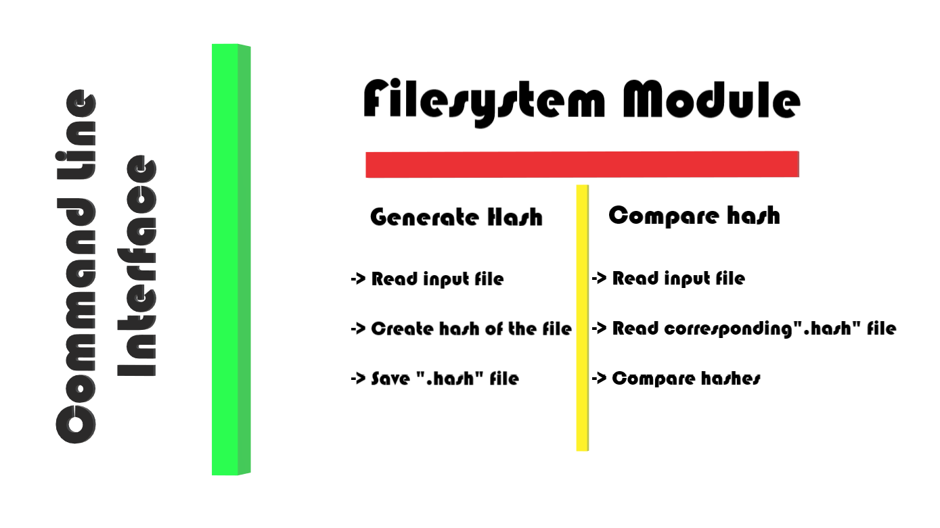

Slide 12
References
Python documentation: https://docs.python.org
MD5 algorithm: https://en.wikipedia.org/wiki/MD5
MD5 example on Geeks-for-Geeks: https://www.geeksforgeeks.org/md5-hash-python/
Regshot tool on Google code archive: https://code.google.com/archive/p/regshot/

Slide 13
The End

